Slide 1

Node application

Slide 2
Creating Node server…
var server = http.createServer(function(req, res) {
res.writeHead(200);
res.end('Hi everybody!');
});

Slide 3
Return response
The message sent back is in plain text, it doesn’t even contain any HTML.
The application always sends back the same message, regardless of the page called (http://localhost:8080, http://localhost:8080/mypage, http://localhost:8080/file/otherpage).

Slide 4
server can return different types of data
Plain text: text/plain
HTML: text/html.
CCS: text/ccs
A JPEG image: image/jpeg
An MPEG4 video: video/mp4
A ZIP file: application/zip

Slide 5
Return HTML
res.writeHead(200);
res.writeHead(200, {"Content-Type": "text/html"});
res.end('<p>Here is a paragraph of <strong>HTML</strong>!</p>');

Slide 6
Concern…
But the HTML code isn’t valid.
We didn’t write a doctype or the <html> or <body> tags.

Slide 7
Continue…
Up to now, we’ve been writing HTML code in res.end().
A better way to divide the code from now on is to use the res.write()
command that allows you to write the answer in several stages. It gives the same result, but our code is better divided this way. res.end() must always be called last to complete the response and ensure that the server sends the result to the client.

Slide 8
var server = http.createServer(function(req, res) {
res.writeHead(200, {"Content-Type": "text/html"});
res.write('<!DOCTYPE html>'+
'<html>'+
' <body>'+
' <p>Here is a paragraph of <strong>HTML</strong>!</p>'+
' </body>'+
'</html>');
res.end();
});
server.listen(8080);

Slide 9
Routing…
var url = require("url");

Slide 10
Route…
var http = require('http');
var url = require('url');
var server = http.createServer(function(req, res) {
var page = url.parse(req.url).pathname;
console.log(page);
res.writeHead(200, {"Content-Type": "text/plain"});
res.write('Well Hello');
res.end();
});
server.listen(8080);

Slide 11
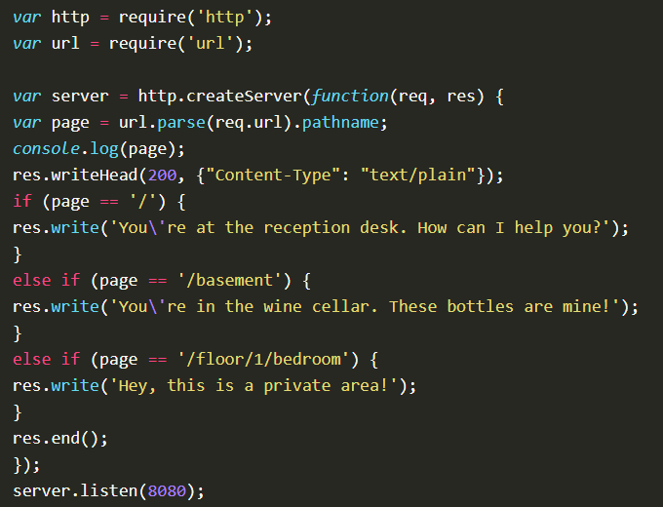

Slide 12
Query params
settings are contained in the ?firstname=John&lastname=Doe string. To retrieve this string, you simply need to use:
url.parse(req.url).query
The problem is that the whole string will be returned to you without first dividing the different settings. Thankfully, there is a Node.js module that takes care of it for us, i.e. querystring!

Slide 13
var querystring = require('querystring');
var params = querystring.parse(url.parse(req.url).query);
params['firstname']

Slide 14
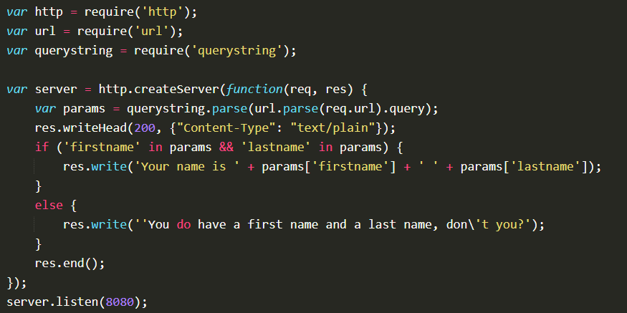

Slide 15
With Node.js, your app must manage the web server (Apache equivalent) in addition to its own features. It should also determine the name of the page called and its settings so it knows what to return to the visitor.
Node.js libraries are called modules and they are loaded using require() .
With Node.js, we frequently send functions in settings of other functions. This determines which function should be called next when a task is finished.
Your app should usually return HTML to the visitor’s browser using the write() method.

Slide 16
Thank you ☺

